Slide 1
Module-2

Slide 2
Word-Level Analysis of Natural Language
Regular Expression(Regex):
It is a language for specifying text search strings
It is a pattern matching standard for string parsing, searching and replacement
Regular expressions are used to parse dates, urls,email,addresses,log files etc
It is used for searching texts in Unix tool –gerp.

Slide 3
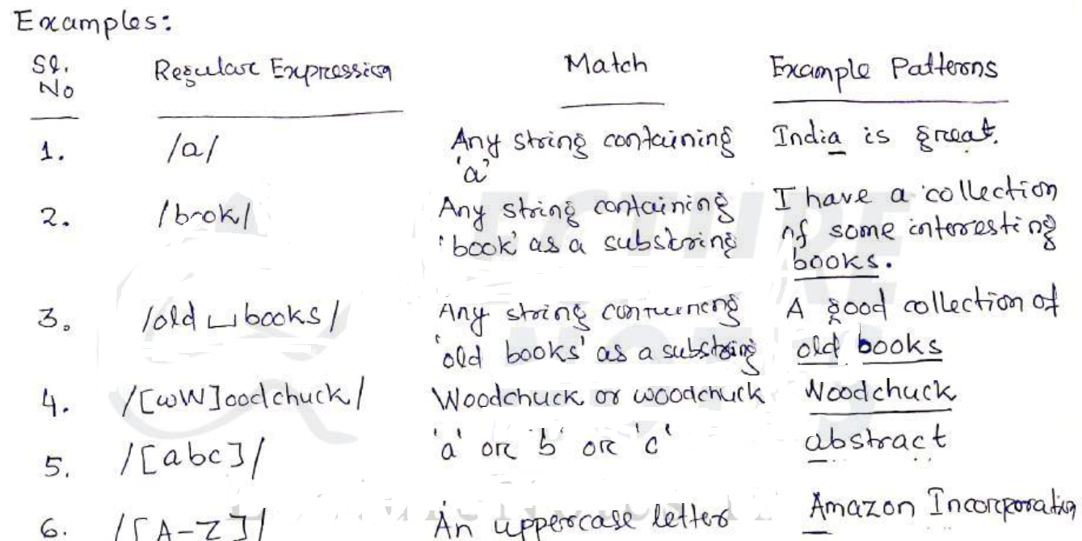

Slide 4
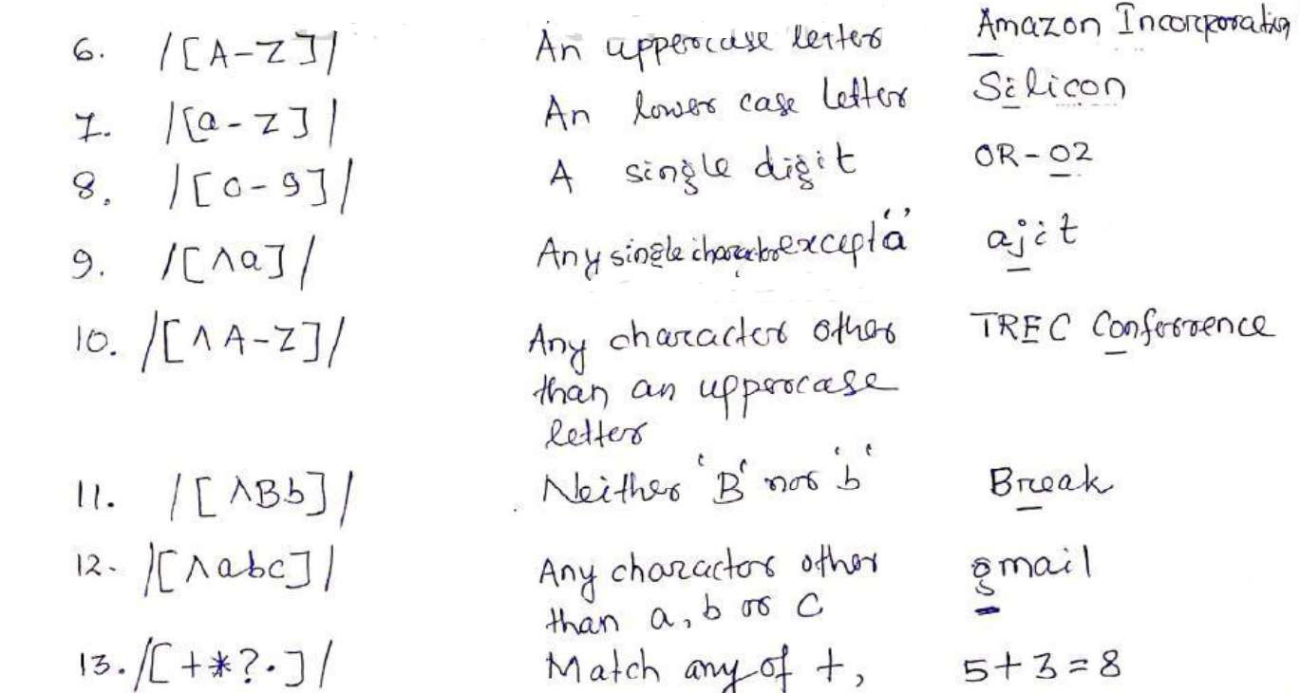

Slide 5
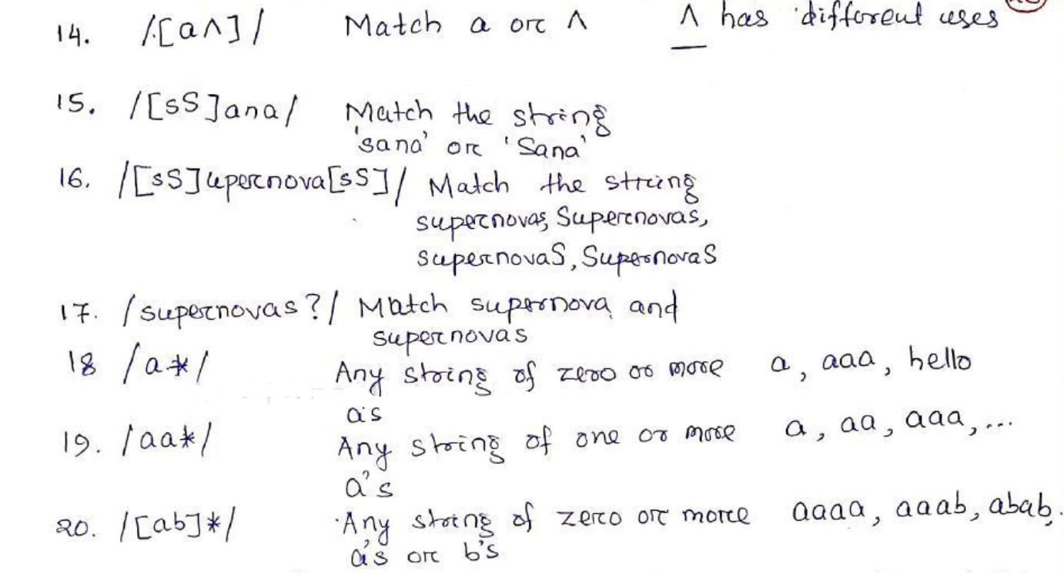

Slide 6
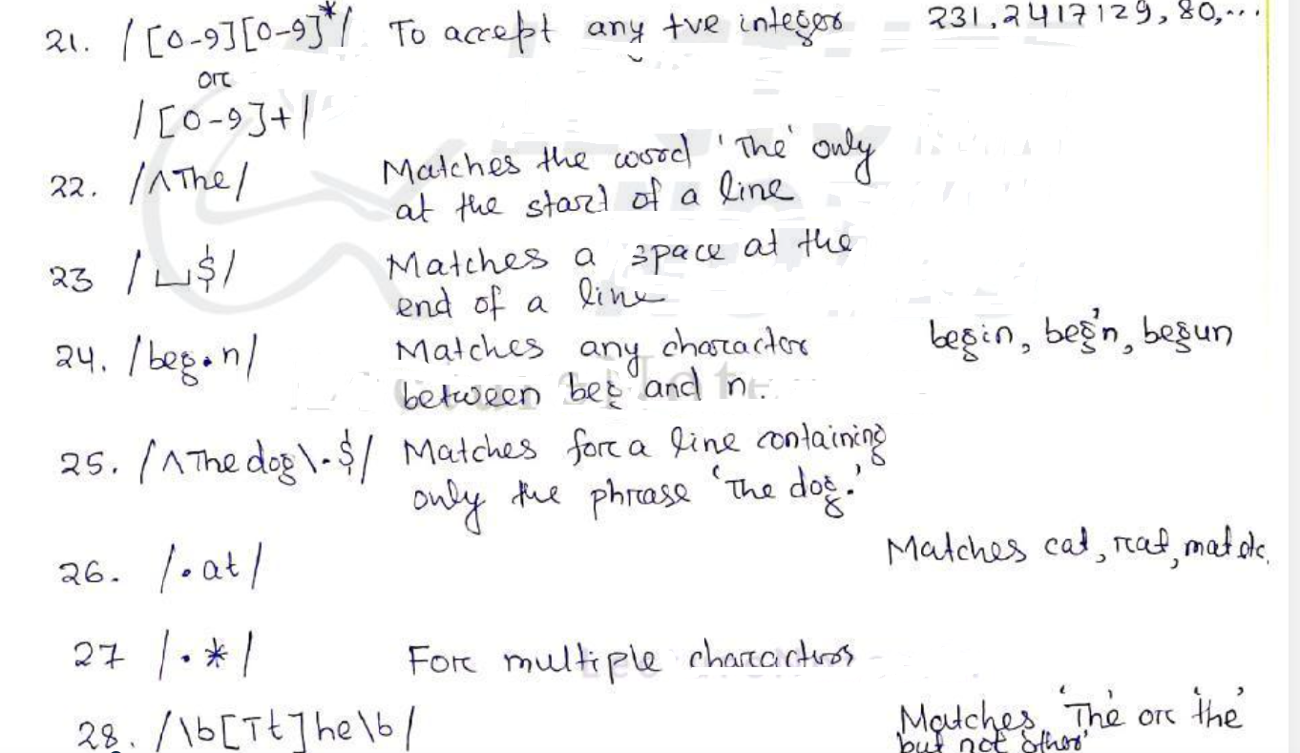

Slide 7
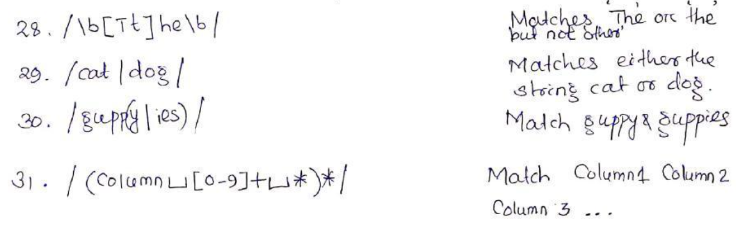

Slide 8
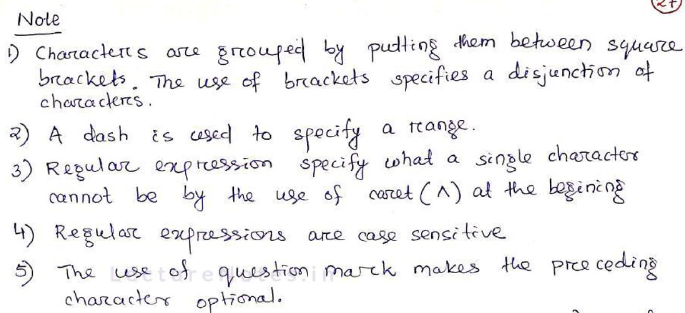

Slide 9
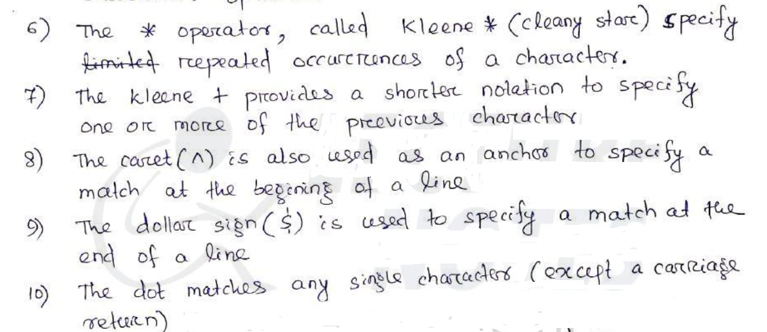

Slide 10
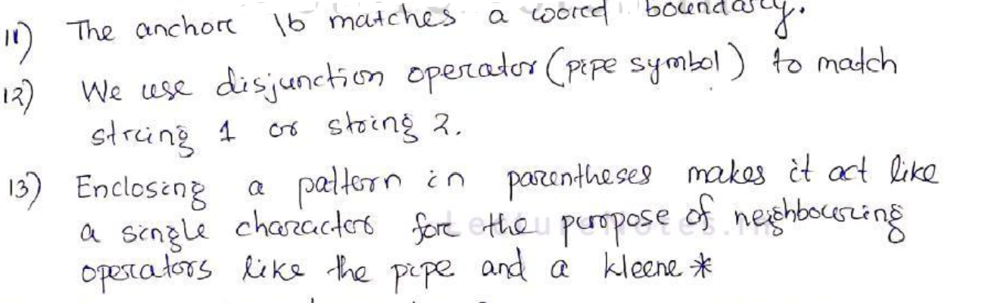

Slide 11
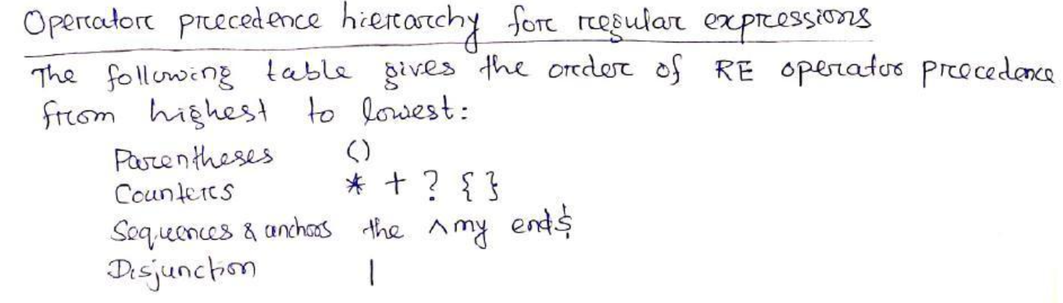

Slide 12
Write RE for the following:
1. to accept strings book or books
2. To accept colour and color.
3. To accept all variations of MHz,Mhz,mHz,mhz,MegaHertz,Megahertz,megaHertz,megahertz
4. To accept any +ve integer with an optional decimal point
5. To check a string is an email address or not.

Slide 13
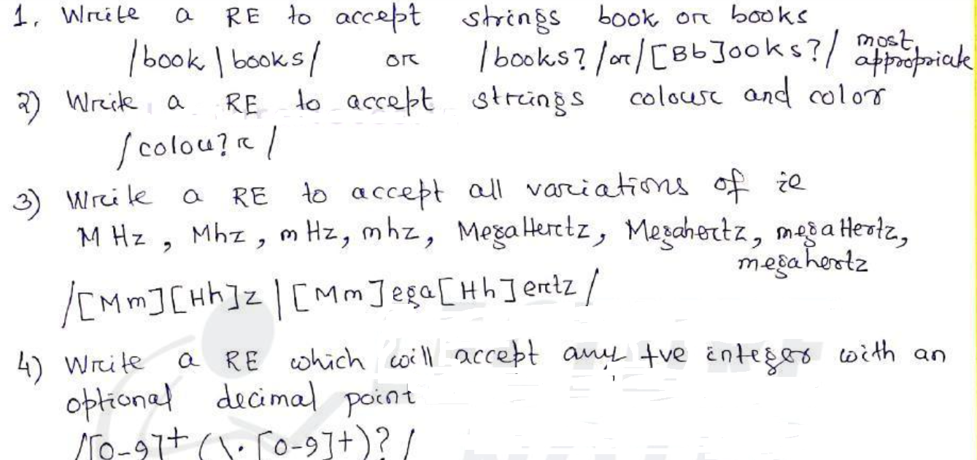

Slide 14
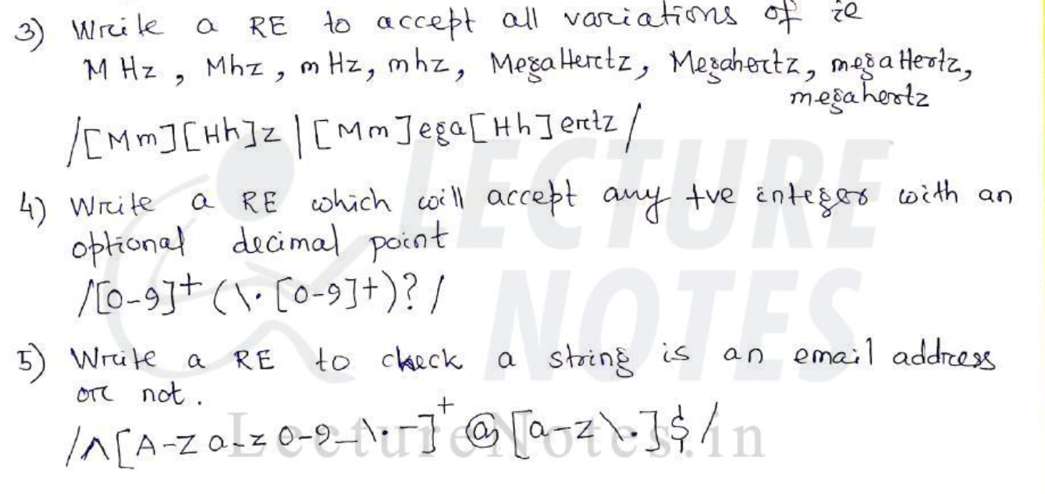

Slide 15
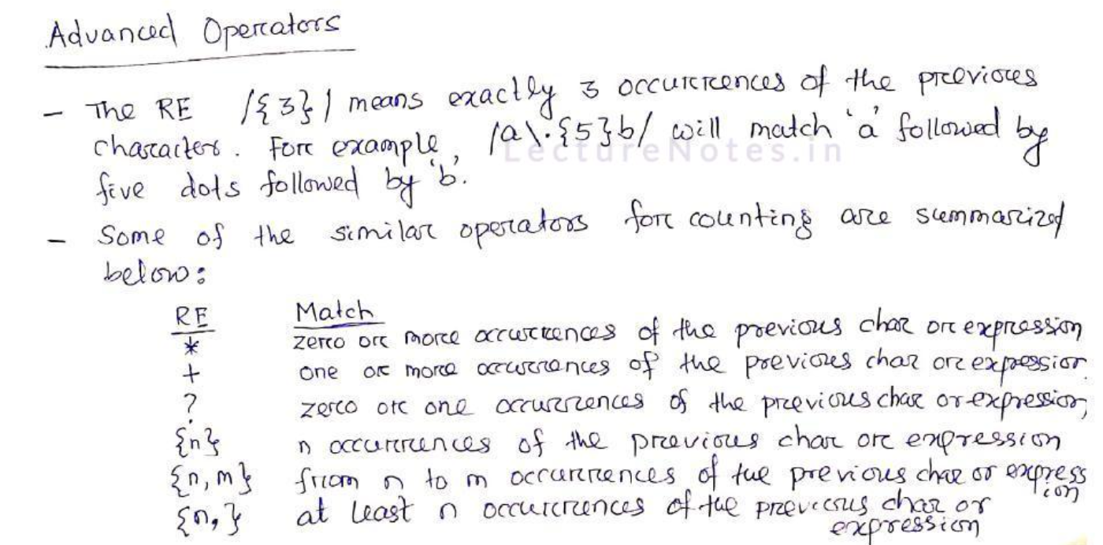

Slide 16
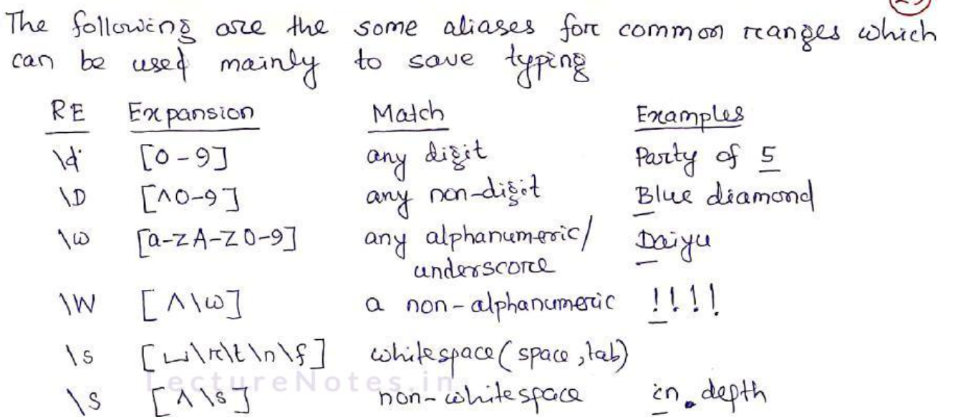

Slide 17
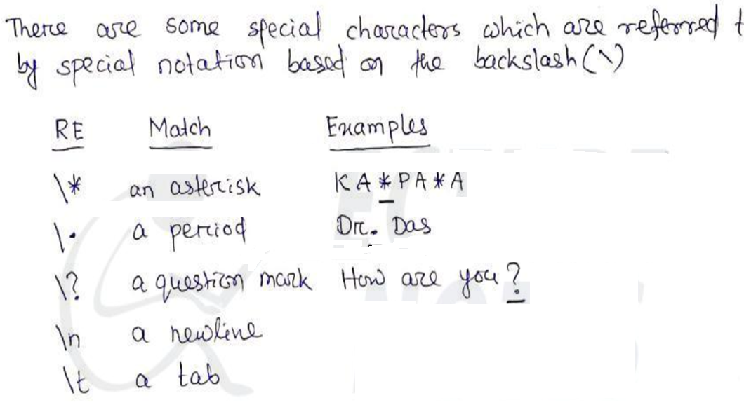

Slide 18
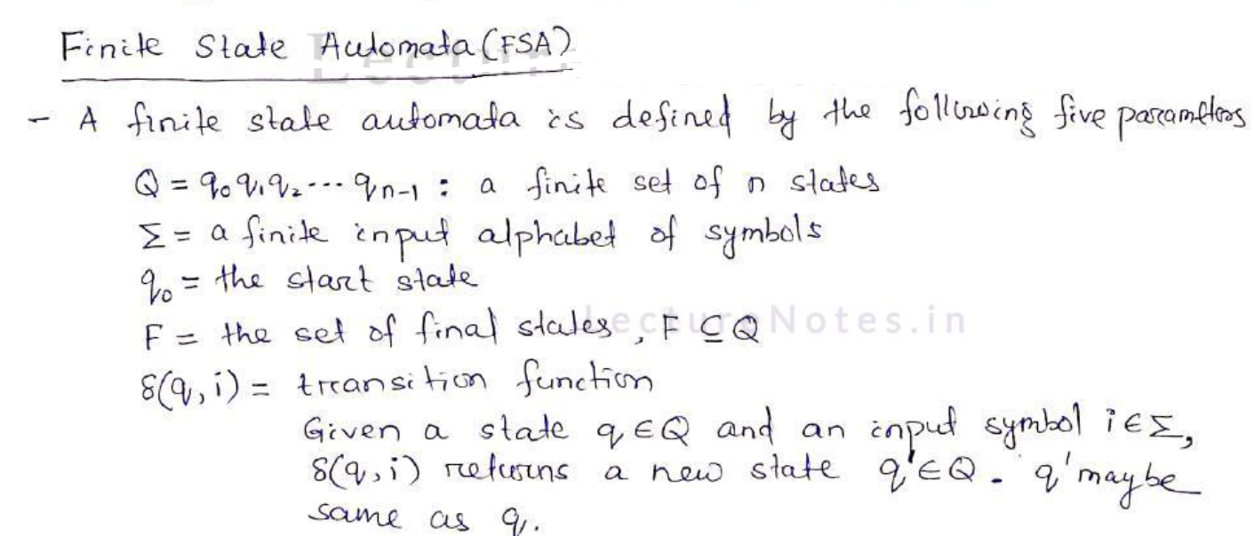

Slide 19
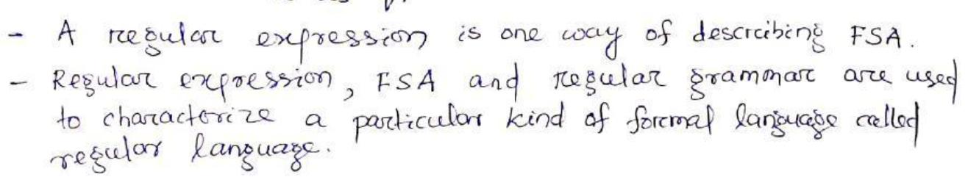

Slide 20
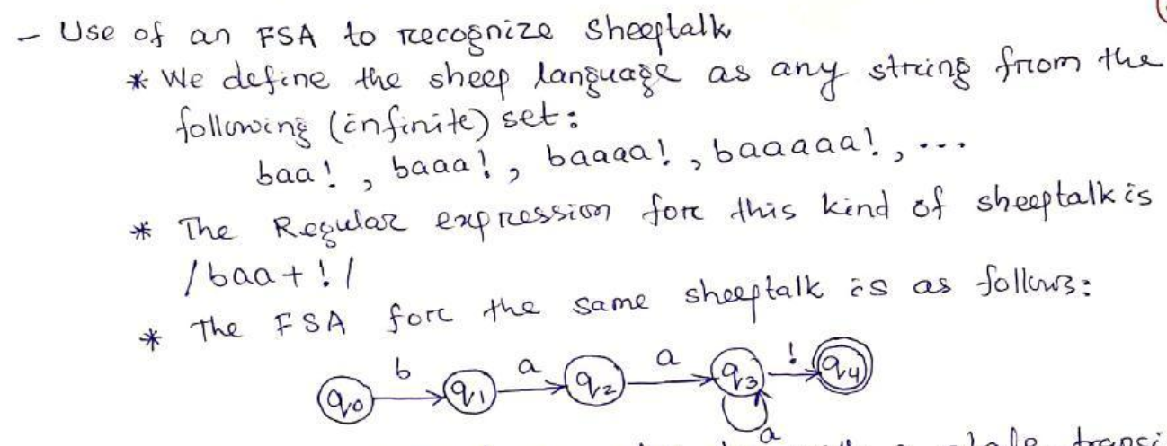

Slide 21
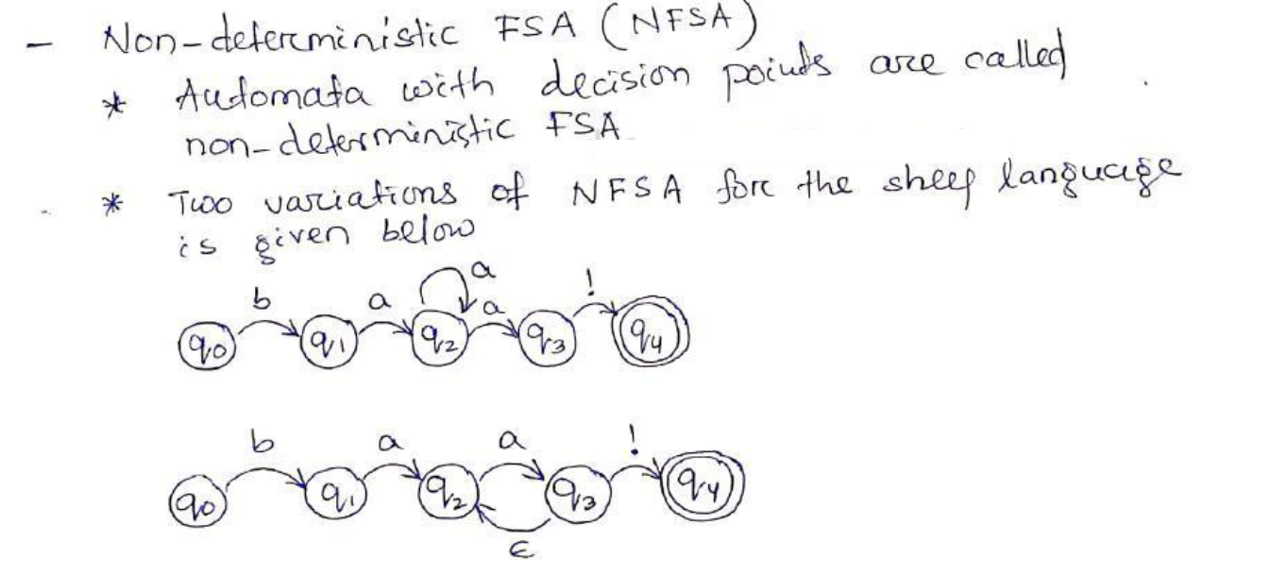

Slide 22
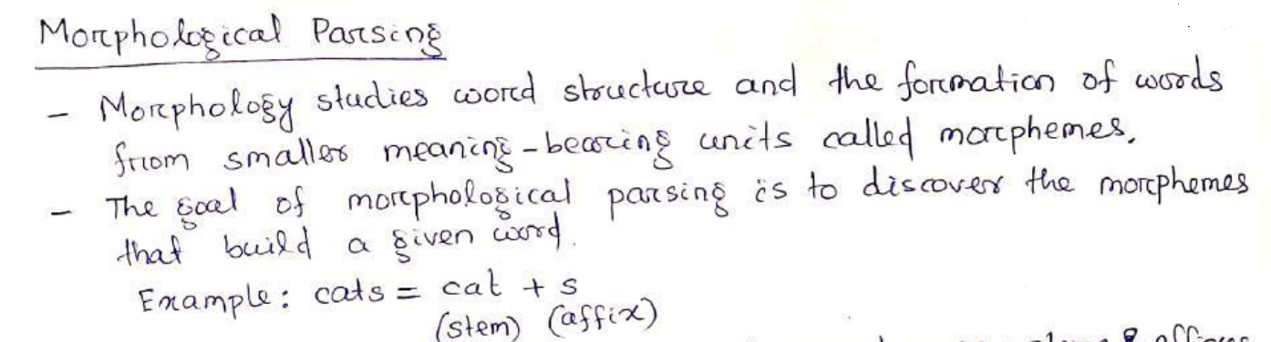

Slide 23
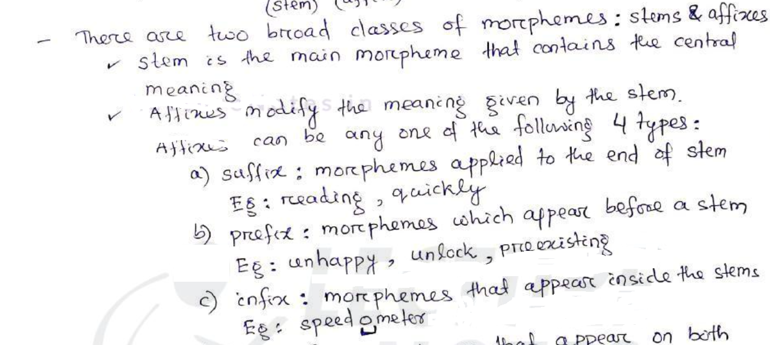

Slide 24
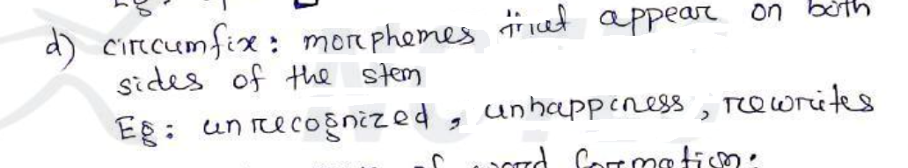

Slide 25
3 main ways of word formation:
1. Inflection: a root is combined with a grammatical morpheme( number, tense, case, gender) to yield a word of the same class as the original stem
Brought-bring
2. Derivation: Creates a new word by changing part-of-speech
It combines a word stem with a grammatical morpheme to yield a word belonging to a different class
Ex: 1. computation from compute
2. teacher from teach

Slide 26
3. Compounding: It is the process of merging two or more words to form a new word
Ex: desktop,overlook

Slide 27
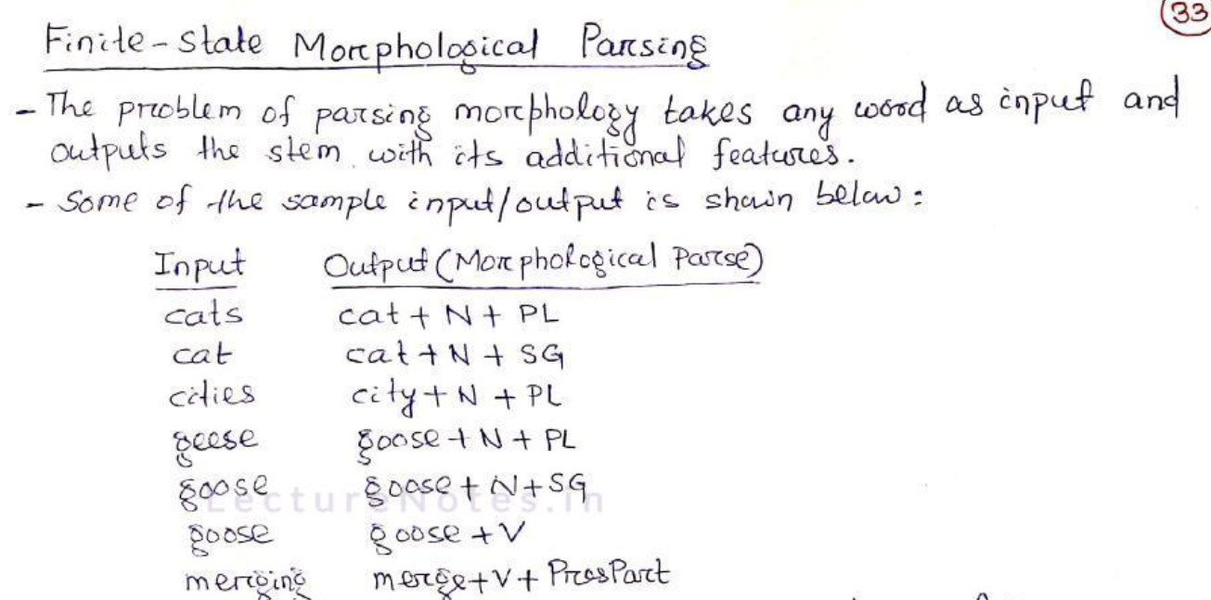

Slide 28
How to build a morphological parser?
Lexicaon: the list of stems and affixes, together with basic information about them
Morphotactics: The model of morpheme ordering that explains which classes of morphemes can follow other classes of morphemes inside a word
Ex: rest-less-ness is a valid word and not rest-ness-less
3. Orthographic rules: These spelling rules are used to model the changes that occur in the word
Ex: the y---- ier spelling rule changes easy to easier and not easyer

Slide 29
Morphological analysis can be avoided if an exhaustive lexicon is available that lists features for all the word-forms of all the roots
Given a word, we simply consult the lexicon to get its feature values
This has several limitations:
It puts heavy demand on memory
Fail to show the relationship between different roots having similar word forms
It is not practical to list all possible word-forms in a language

Slide 30
The simplest morphological systems are stemmer that converts morphological variations of a given word to its stem
Stemmers don’t require a lexicon, instead it uses a set of rewrite rules of the form:
ex : ier---y (earlier--→ early)
ing --- nothing or epsilon ( playing ---→ play)

Slide 31
Stemming algorithm works in 2 steps:
Suffix removal: this step removes predefined ending from words
Recoding: this step adds predefined ending to the output of the first step.
Ex : easier -→ easy
Drawbacks:
Stemmers are not perfect for morphologically rich languages

Slide 32
Different levels of morphological model:
Surface level: represents the actual spelling of the word
Lexical level: represents the concatenation of its constituents morphemes
In this model , a word is represented as a correspondence between its lexical level form and its surface level form
ex books
book +N+PL
This model is usually implemented with FST( Finite State Transducer)

Slide 33
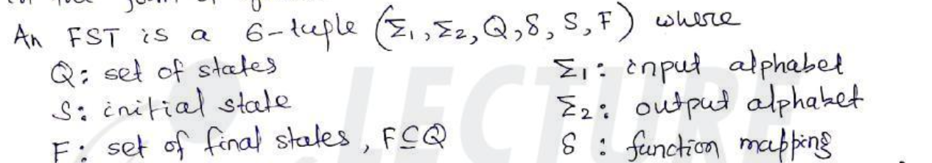

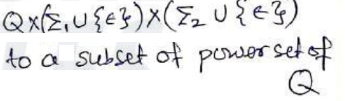
Finite State Transducer(FST)
It is a type of finite automation which maps between two set of symbols
It passes over the input string by consuming the input symbols from the input tape and produces the output in the form of symbols

Slide 34
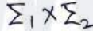
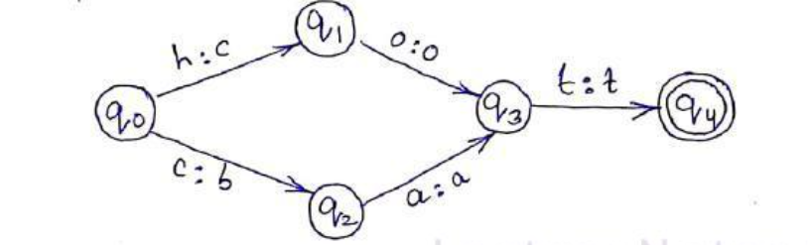
The transducers can be seen as automata with ttransitions labelled with symbols from
The following figure shows a simple transducer that accepts two input strings hot and cat and maps them onto cot and bat

Slide 35
Spelling Error Detection and Correction
80% of the typing errors and misspellings are:
1. Substitution of a single letter
2. Omission of a single letter
3. Insertion of a single letter
4. Transposition of two adjacent letters
Shafer and Hardwick(1968) found that the common errors in decreasing order of occurrence are substitution, omission, insertion

Slide 36
Optical Character Recognition (OCR) and other automatic reading devices introduce errors of substitution, deletion and insertion
Unlike typing errors , spelling errors are mainly phonetic where the misspell word is pronounced in the same way as the correct word
Spelling errors belong to two distinct categories:
Non-word errors
Real-word errors
Non word error: when an error results in a word that does not appear in a given lexicon or is not a valid orthographic word form
ex: leve------→leave

Slide 37
2. Real word error: when errors result in a word is another actual word of the language
It may cause local syntactic error, global syntactic error .

Slide 38
Spelling correction consists of detecting and correcting errors
These problems are addressed in two ways:
Isolated error detection and correction:
Each word is checked separately , independent of its context
Simple solution is to look up the word in a lexicon
There are some problems associated:
it needs the existence of a lexicon containing all correct words which would take a long time to compile and occupy a lot of space

Slide 39
For some languages it is impossible to list all the correct words
Strategy fails for real –world errors
Larger the lexicon , more likely it is that an error goes undetected
Because the chance of a word being found is greater in a large lexicon

Slide 40
Context – dependent error detection and correction:
Utilize the context of a word to detect and correct errors
Requires grammatical analysis and hence more complex and language dependent
The list of candidate words must first be obtained using an isolated – word method, before making a selection depending on the context

Slide 41
Spelling correction algorithms are broadly classified as:
1. Minimum edit distance:
The minimum edit distance between 2 strings is the minimum number of operations (insertions,deletions,sustitutions ) required to transform on string into another
2. Similarity Key techniques:
In this we change a given string into a key such that similar strings will be changed into the same key

Slide 42
3. n-gram based technique:
Can be used for both non-word and real-word error detection
Strings that contain unusual n-grams can be identified as possible spelling errors
This technique needs a large corpus as training data
In he case of real world error detection , we calculate the likelihood of one character following another and use this information to find possible correct word candidates

Slide 43
4. Neural nets: these have the abilty to do associative recall based on incomplete and noisy data
5. Rule based techniques:
A set of rules (heuristics) derived from knowledge of a common spelling error patterns is used to transform misspelled words into a valid words

Slide 44
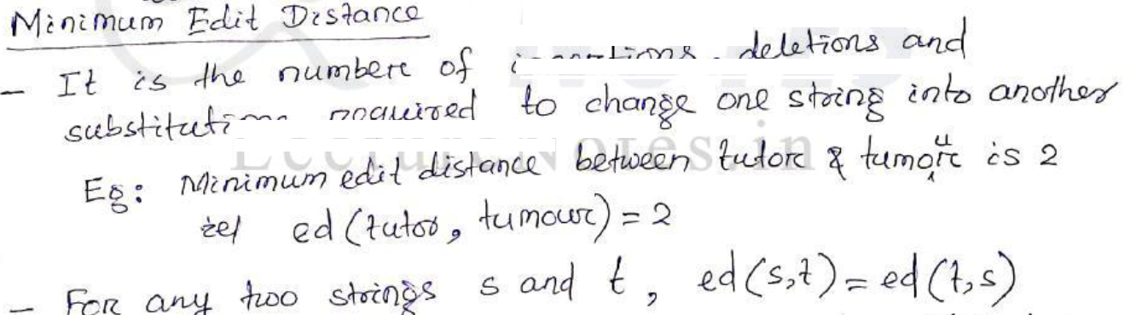

Slide 45
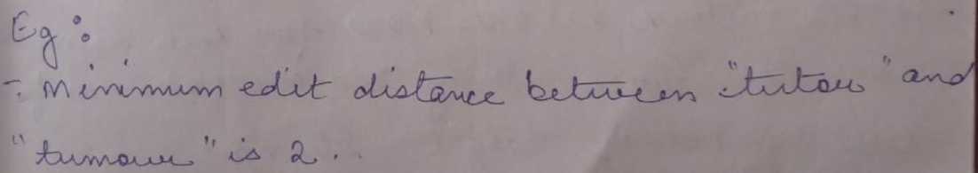

Slide 46
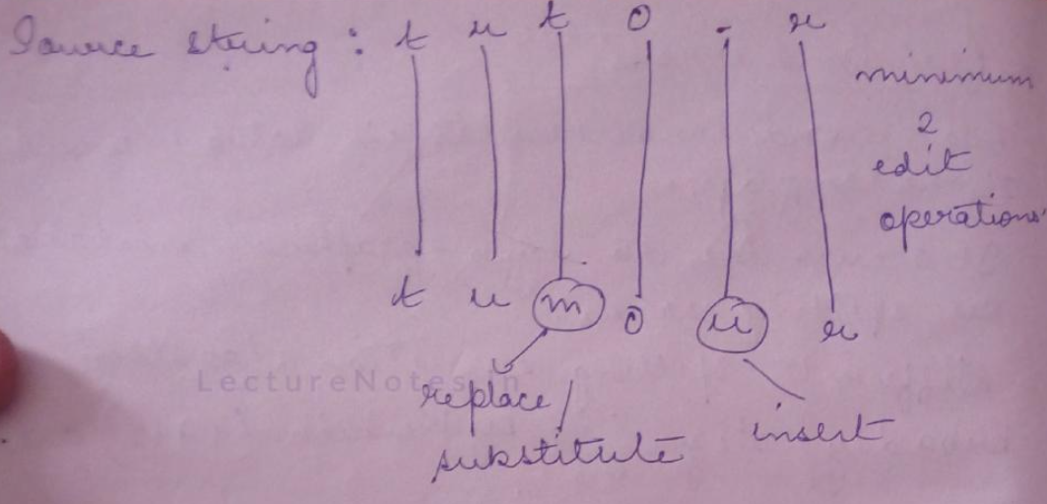

Slide 47
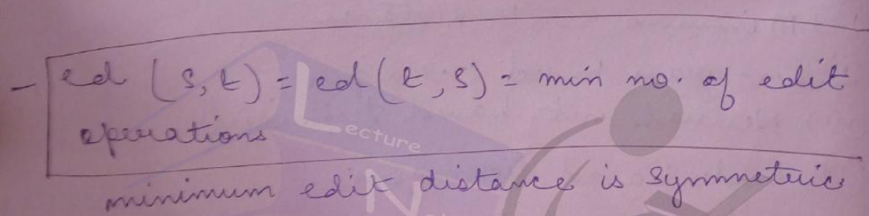

Slide 48
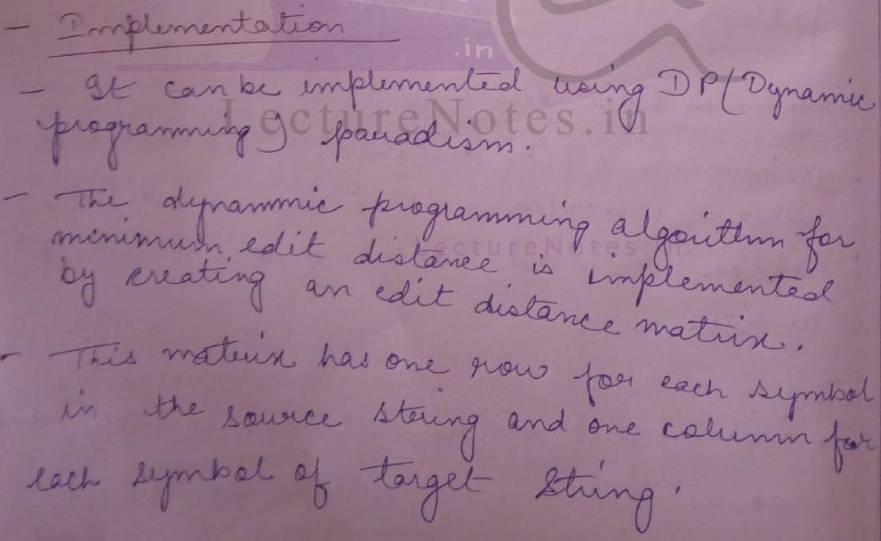

Slide 49
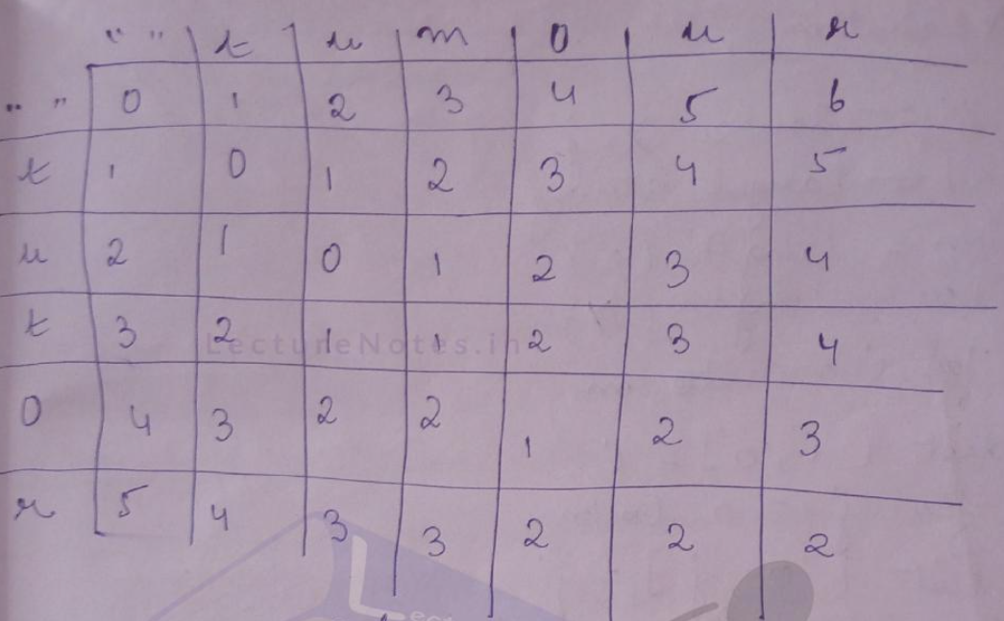

Slide 50
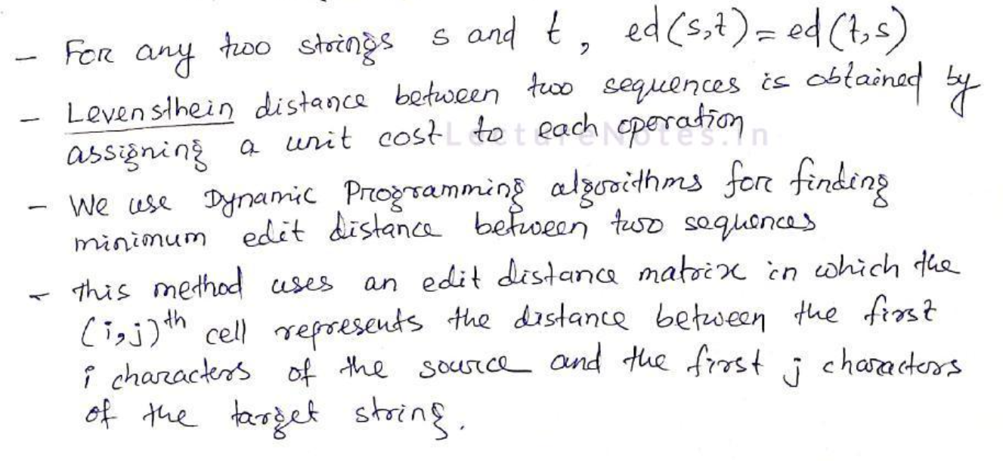

Slide 51
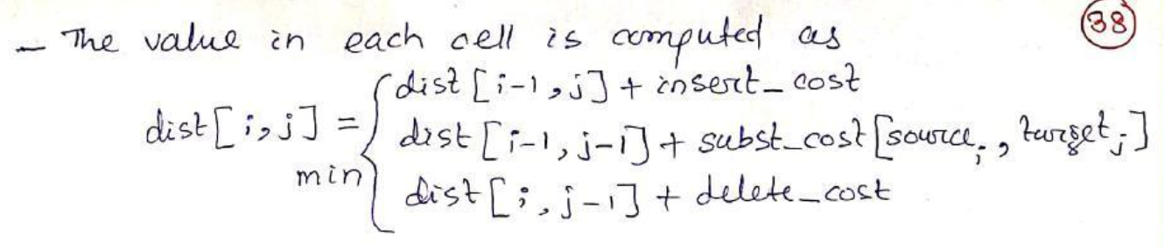

Slide 52
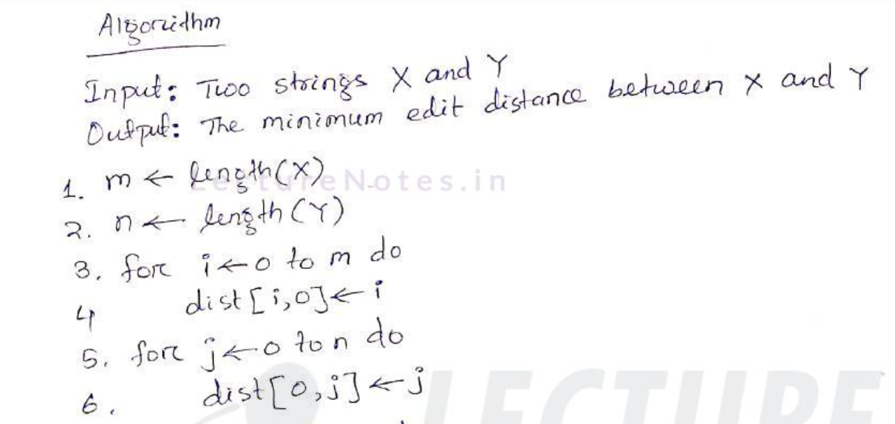

Slide 53
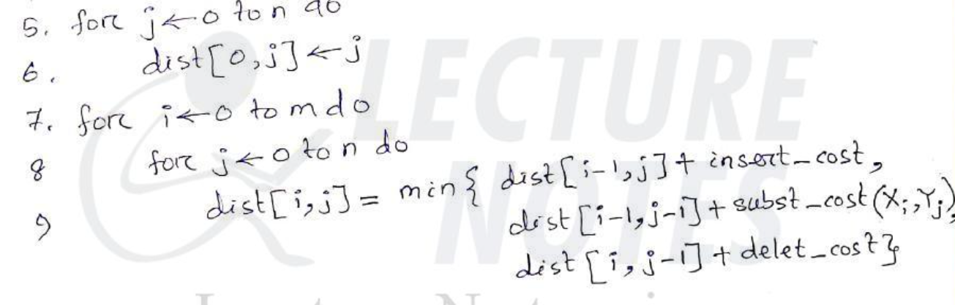

Slide 54
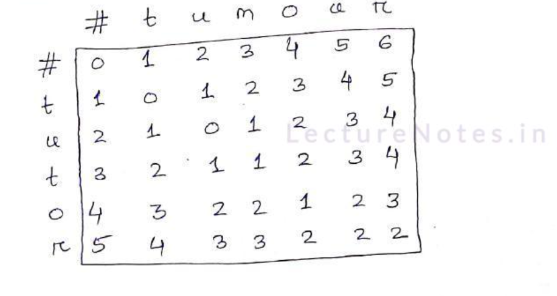

Slide 55
Words and Word Classes
Words are classified into categories called parts-of-speech or word classes or lexical categories
These lexical categories are defined by their syntactic and morphological behaviours

Slide 56
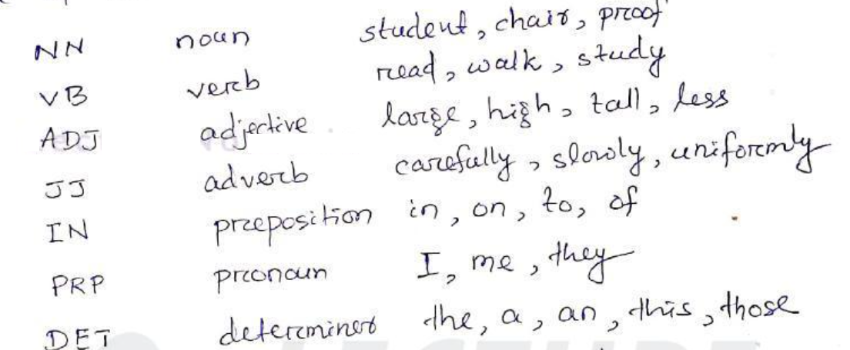
Some of the word classes in English language are:

Slide 57
Word classes are further categorised as:
Open word class: (Content words)
It constantly acquire new members.
Ex: Nouns, verbs, adjectives, adverbs etc.
2. Closed Word class: (function words)
- Does not allow new member
- Words that have little lexical meaning
Ex: prepositions, determiners

Slide 58
Parts of Speech Tagging:
process of attaching a tag to each word in a sentence
The set of tags is called tag-set
Standard tag set is Penn Tree bank
Some POS tags from Penn Tree bank tag sets are:
NN – Noun (ex : Dog _NN or Dog/ NN or Dog[NN]
VB- verb base form (ex: eat –VB)
VBD – Verb, past tense (ex: ate – VBD)
VBN- Verb, past participate( ex: eaten – VBN)
IN- preposition
JJ - Adjective

Slide 59
DT – Determiner
PRP- pronoun
Needs- needed as an initial processing step for a number of NLP applications
Challenge- Words often have more than one parts of speech (POS)
Ex: This is a simple sentence
POS Tagging:
This/DET is /VB a/DET simple/ADJ sentence/NN
Penn Treebank
This/DT is /VB a/DT simple/JJ sentence/NN

Slide 60
Write POS tagging for the following:
1. Book that flight
2. Does that flight serve dinner?

Slide 61
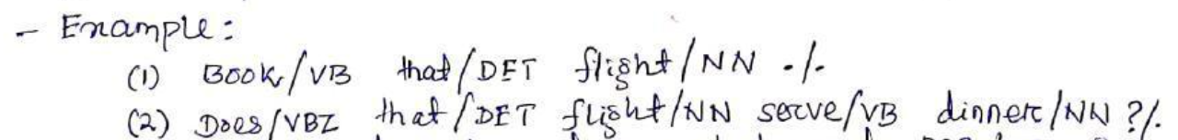

Slide 62
Assigning a tag to each word is not trivial
POS- tagging is to resolve the ambiguity of choosing the right tag
POS tagging is an early stage of text processing in many applications including speech synthesis, machine translation, information retrieval and information extraction

Slide 63
POS tagging methods fall under 3 general categories:
1. Base line method
2. Rule – based (linguistic)
3. Stochastic (data- driven)
4. Hybrid

Slide 64
Baseline method/ basic method:
Tagging unambiguous words with the correct label
Tagging ambiguous words with their most frequent label
Tagging unknown words a noun

Slide 65
2. Rule based Tagger
Use hand- coded rules to assign tag to words
These rules use a lexicon to obtain a list of candidate tags and then use rules to discard incorrect tags
Most of the rule-based taggers have two-stage architecture:
a. 1st is simply a dictionary look-up procedure: returns a set of
potential tags and appropriate syntactic features for each word
b. 2nd uses a hand-coded rules to discard contextually illegitimate tags
to get a single part-of-speech for each word

Slide 66
Example:
The show must go on
Potential tags for the word show is { VB,NN}
The ambiguity is resolved by using the following rule:
IF preceding word is determiner THEN eliminate VB tag
IF word ends in –ing and preceding word is a verb THEN label it a verb (VB)

Slide 67
Capitalization information can be utilized in the tagging of unknown nouns
Advantages:
Speed of tagging is best
Deterministic technique
Disadvantages:
It requires skill and effort to write disambiguation rules
More time is spent in writing rule-set
Rules are language dependent

Slide 68
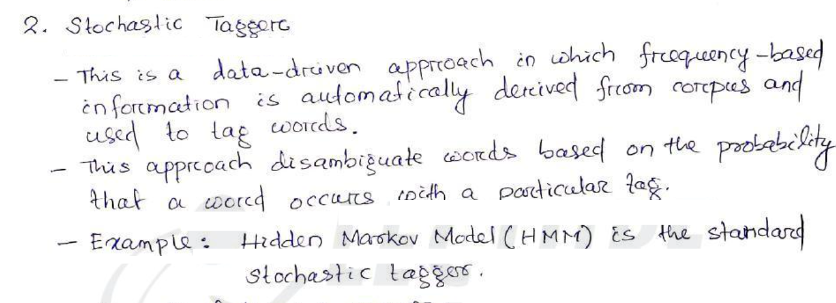

Slide 69
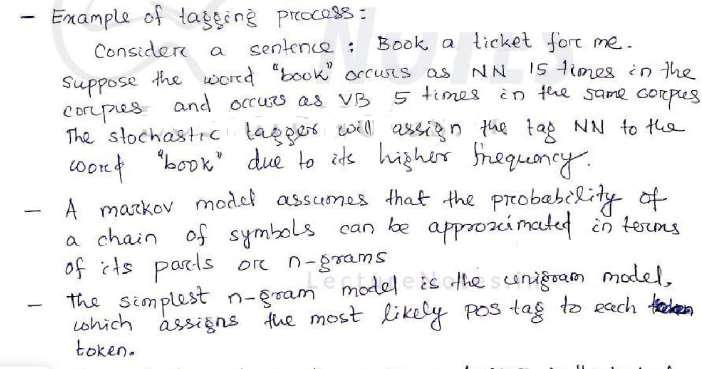

Slide 70
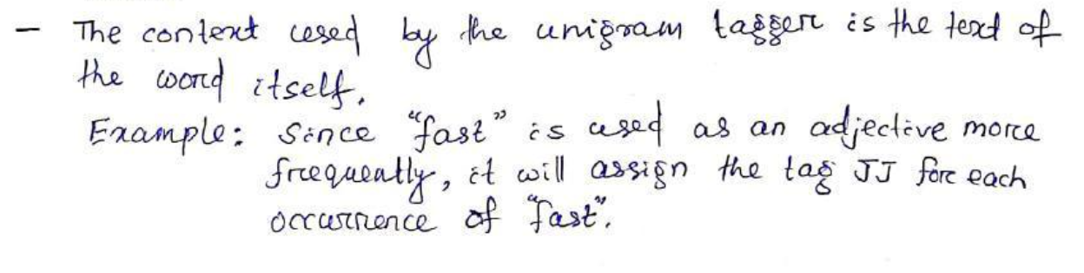

Slide 71
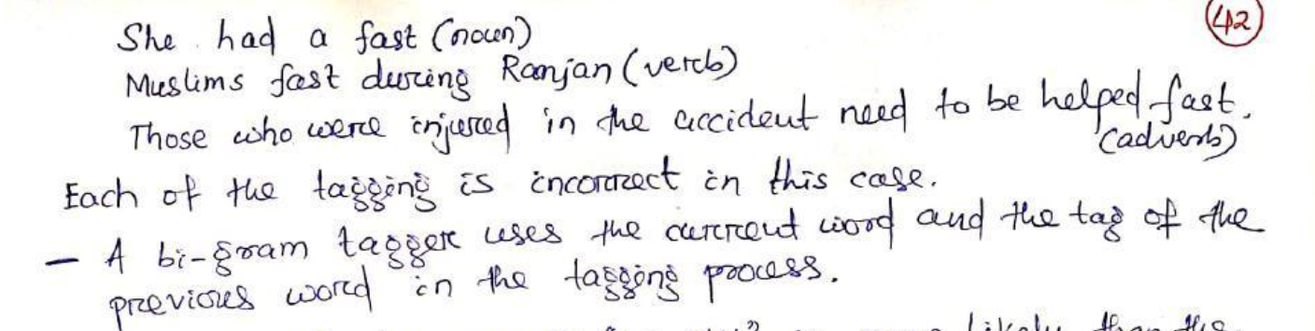

Slide 72
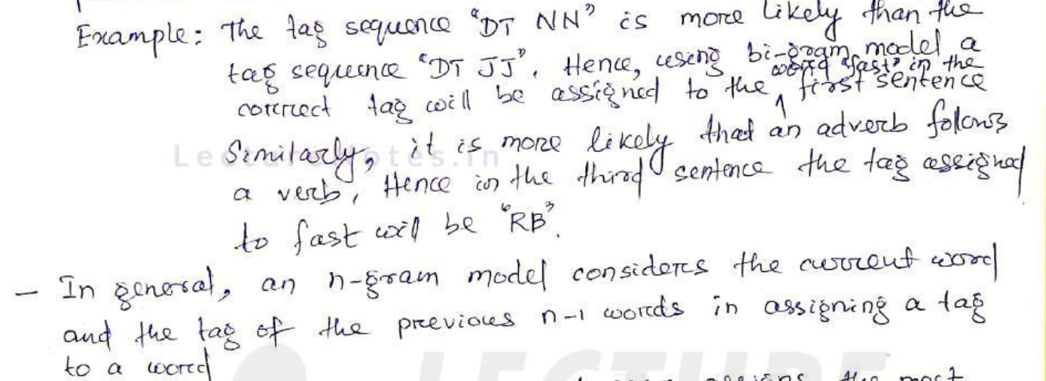

Slide 73
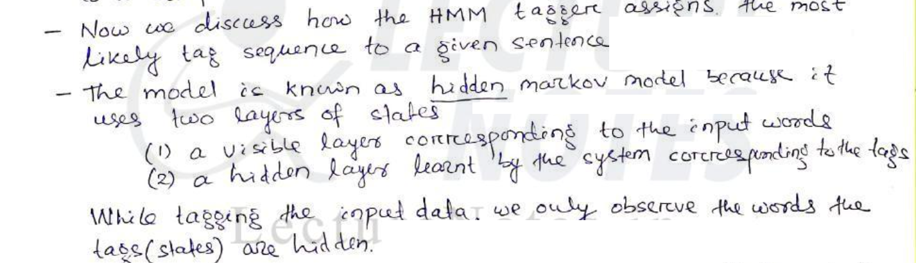

Slide 74
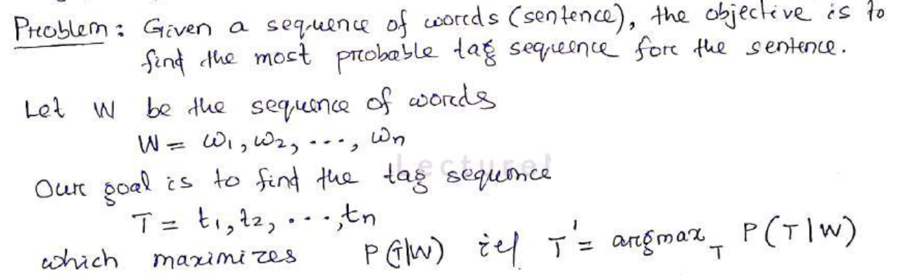

Slide 75
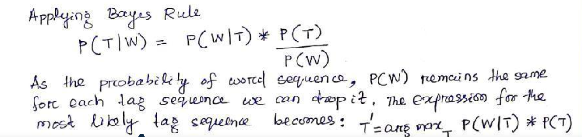

Slide 76
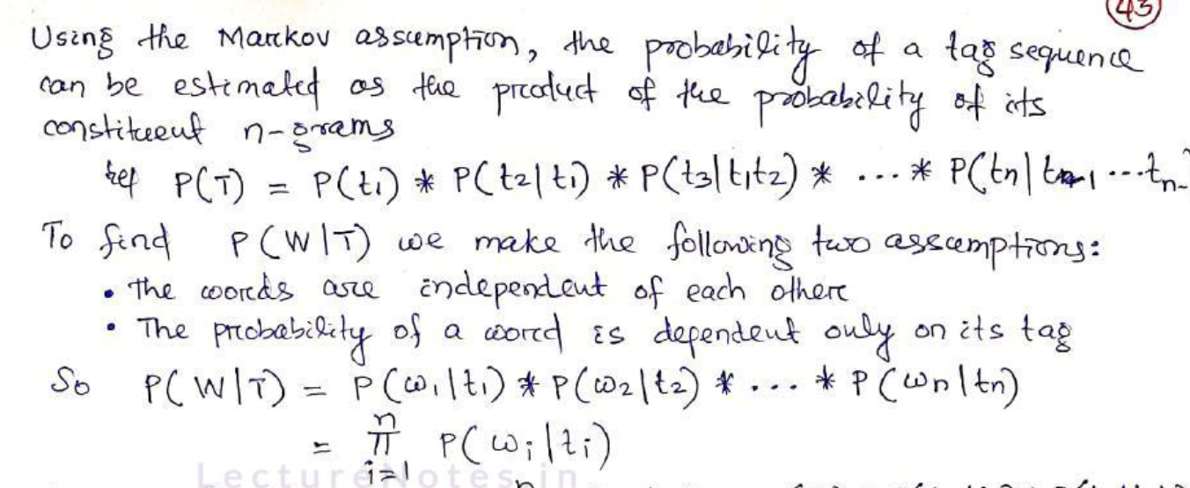

Slide 77
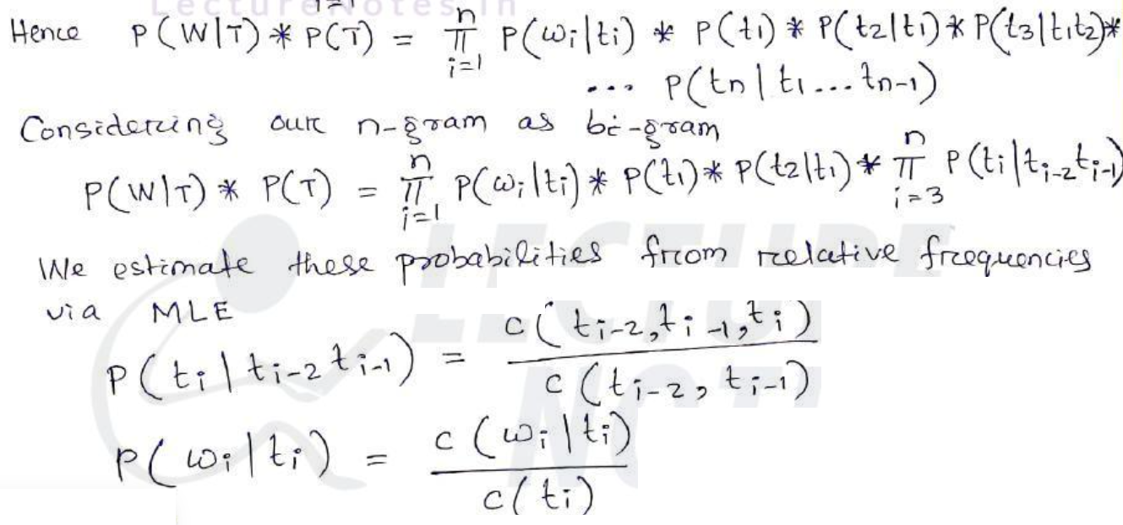

Slide 78
C(ti)- Frequency of ti in the corpus
C(Wi ti)-Frequency of Wi|ti in the copus , where Wi is word and ti is tag
C(ti-1 ti) – Frequency of ti-1 ti in the corpus

Slide 79
Example 2
From Brown Corpus(data set) given :
P(NN|To)=0.021
P(race|NN)=0.00041
P(VB|To)=0.34
P(race|VB)=0.00003
Based on Brown corpus find the tag sequence for the following sequence.

Slide 81
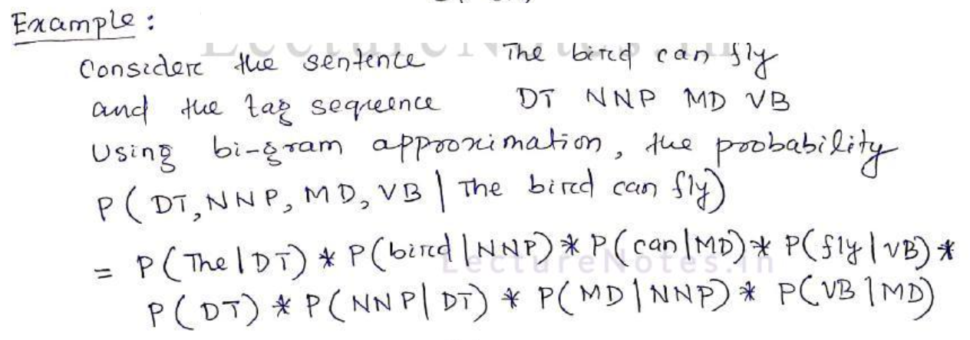

Slide 82


Slide 83


Slide 84


Slide 85


Slide 86


Slide 87
Issues of Hybrid Tagger
Lack of annotated corpus for training in many languages
Problems in tagging of unknown words:
The words that do not appear in dictionary or a training corpus , create problem during tagging

Slide 88
Solutions to tagging of unknown words
Assign the most frequent tag( which occurs with most word types in the training corpus) to the unknown word
Assume that the unknown words can be of any part-of-speech and initialize them by assigning them open class tags. Then proceed to disambiguate them using probabilities of those tags
[NER] Named Entity Recognition
- It identifies and classifies the words in a sentence into different
categories such as people, place, time etc.

